Slide 1

Project Work - II
MEDICAPS UNIVERSITY
Presentation by:
Project Title: Geospatial application development for primary field data.
Organization: Indian Institute of Technology, Bombay
Tanishq Dayma
EN16CS301276
CS – ‘E’

Slide 2

Indian Institute Of Technology
Bombay
Research Internship Awards 2019-20
Computer Science and Engineering Department
Project Description
Project Title: Geospatial application development for primary field data.
Principal Investigator: Prof. Om P. Damani

Slide 3
Description of Organization
This is a project of Technology and Development Solutions Cell (TDSC), CTARA, IIT Bombay. This is a resource center for providing technology-based solutions for the development sector. TDSC provides resources and services to undertake projects that deliver outputs via academic research, consulting, outreach modules, entrepreneurship guidance, etc. TDSC not only aims at delivering solutions to external stakeholders but primarily uses the academic platform to engage students directly in development-related problems and solutions.
TDSC operates as a CTARA project under IIT Bombay's Industrial Research and Consulting Centre (IRCC).

Slide 4
Problem at hand
The Project primarily deals with Geospatial data (GIS formats like shapefile). TDSC is an organization that does neutral third party audits of the projects, some of which are sanctioned by the Government of Maharashtra.
So, they require a system to store all their geospatial data on a centralised server that can be used to handle all the data addition and updating. This server must also have a provision to get integrated with the QGIS software, currently being utilised by the TDSC members.
Another project is to develop a Geospatial application(CommunityGIS) that will create significant improvements in the efficiency of research work at TDSC as well as that of any other current and future research groups and members of the community.
Along with this there is a website development that I was a part of for the first one month for Unnat Maharashtra Abhiyan(UMA) which is a project of the Ministry of Higher and Technical Education.(http://104.211.185.20/)
One of my secondary tasks, is to maintain the current website of TDSC by regularly updating the website with new content. Now, they want a new website designed specifically for TDSC.

Slide 5
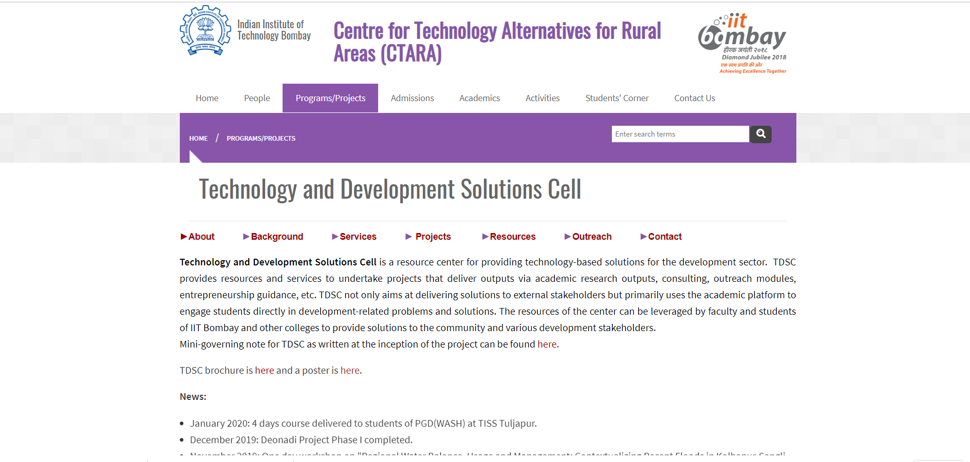
Current Website of TDSC, CTARA
http://www.ctara.iitb.ac.in/en/tdsc

Slide 6
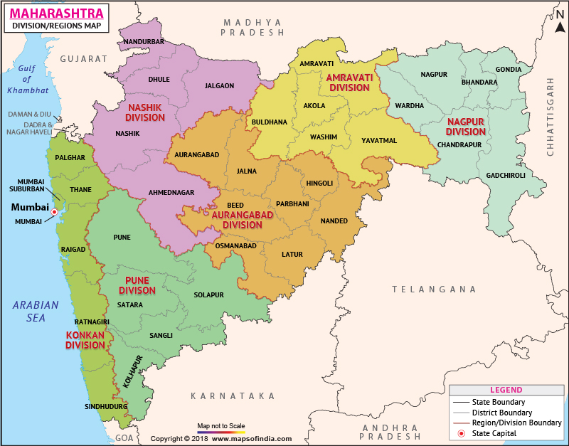
Geospatial Data
Geospatial data is data about objects, events, or phenomena that have a location on the surface of the earth. The location may be static in the short-term (e.g., the location of a road, an earthquake event, children living in poverty), or dynamic (e.g., a moving vehicle or pedestrian, the spread of an infectious disease). Geospatial data combines location information (usually coordinates on the earth), attribute information (the characteristics of the object, event, or phenomena concerned), and often also temporal information (the time or life span at which the location and attributes exist).

Slide 7
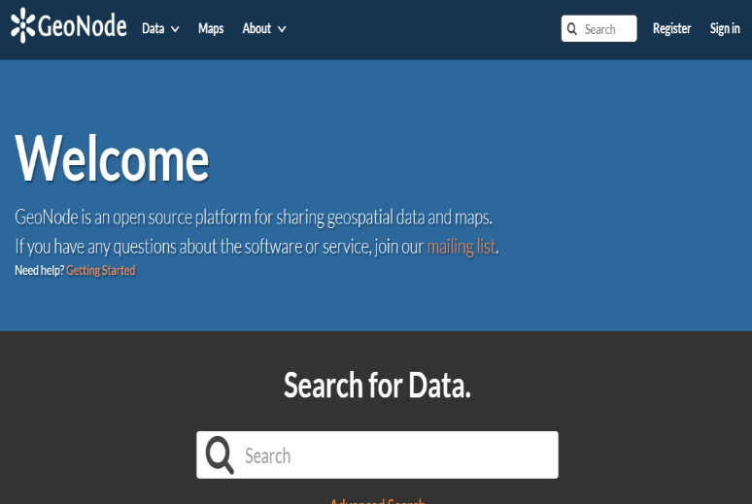
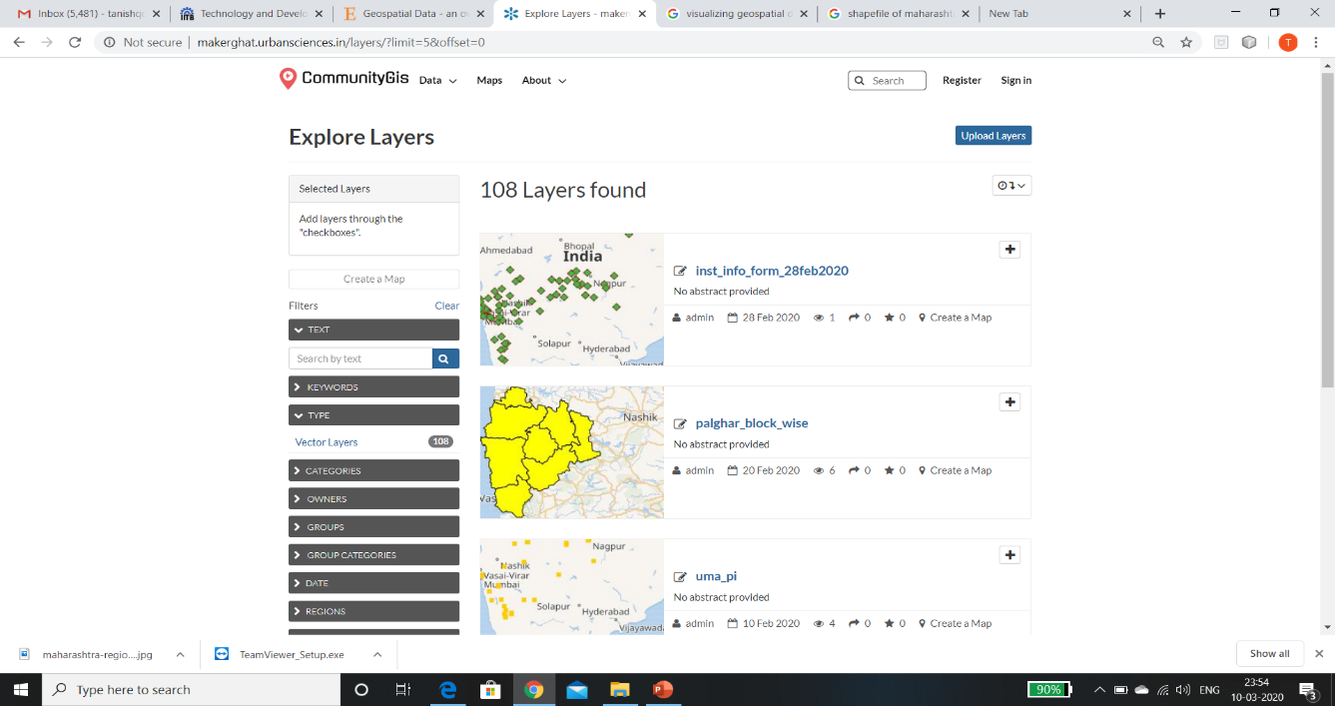
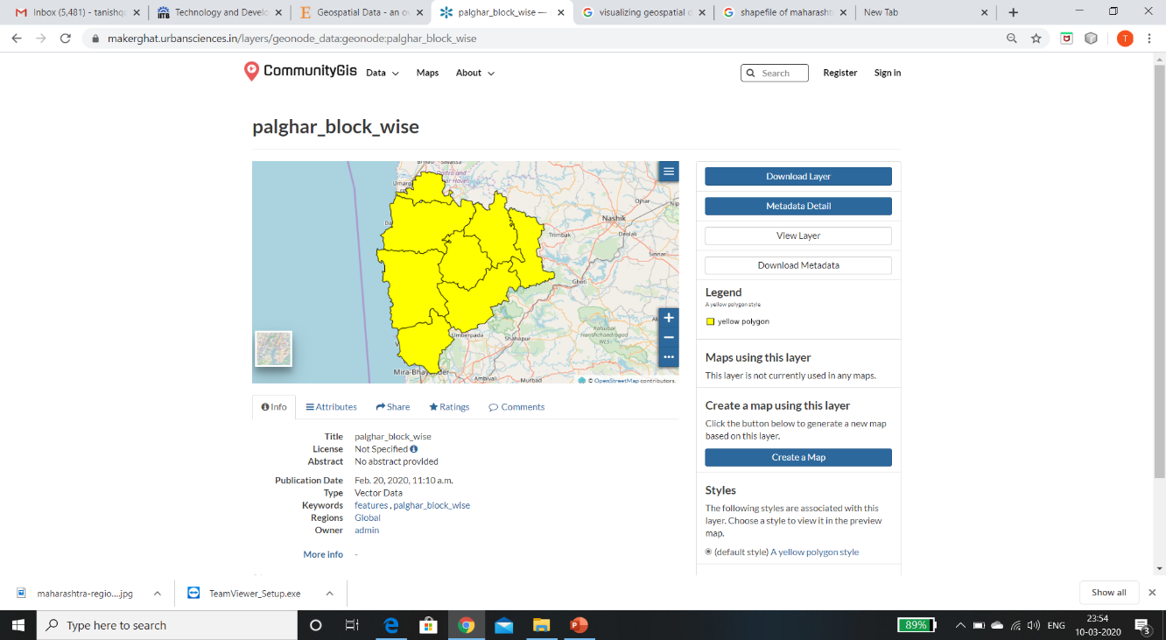
GIS and Geonode
TOOLS:
A geographic information system (GIS) is a framework for gathering, managing, and analyzing data. GIS integrates with many different kinds of data layers using spatial location. The system being used is Geonode. It is an Open Source, Content Management System (CMS) for geospatial data. It is a web-based application and platform for developing geospatial information systems (GIS) and for deploying spatial data infrastructures (SDI).

Slide 8
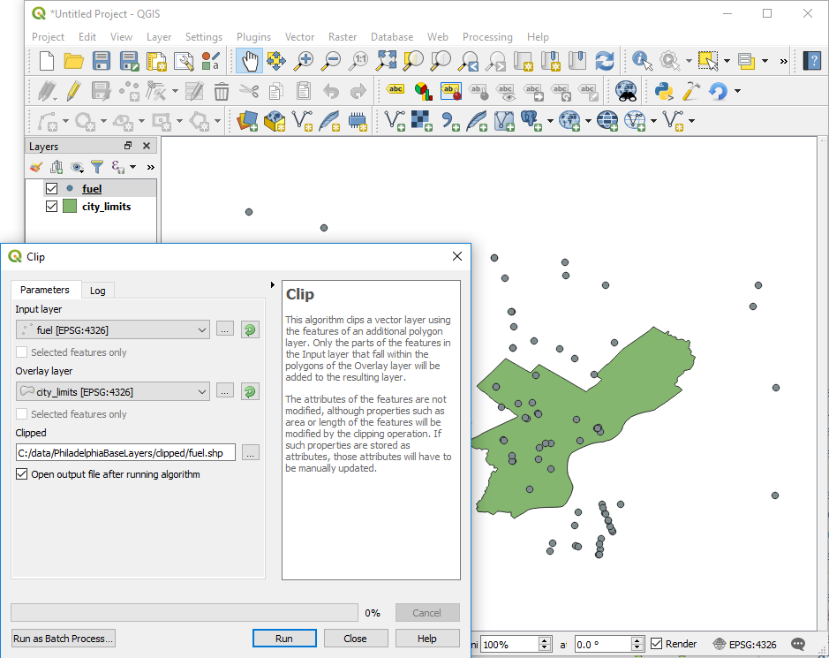
QGIS Software
QGIS is a free and open-source cross-platform desktop geographic information system (GIS) application that supports viewing, editing, and analysis of geospatial data.
QGIS integrates with other open-source GIS packages, including PostGIS, GRASS GIS, and MapServer. Plugins written in Python or C++ extend QGIS's capabilities. Plugins can geocode using the Google Geocoding API, perform geoprocessing functions similar to those of the standard tools found in ArcGIS, and interface with PostgreSQL/PostGIS, SpatiaLite and MySQL databases.

Slide 9
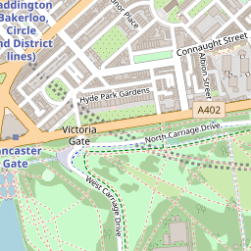
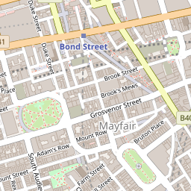
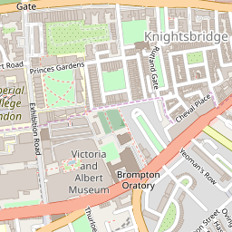
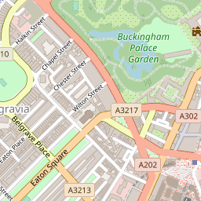
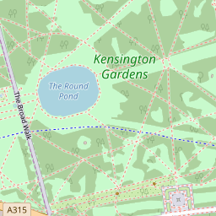
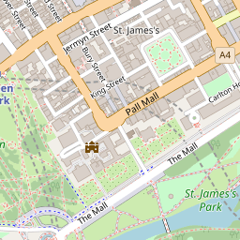
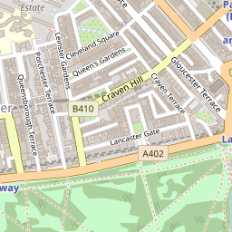
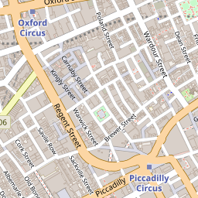
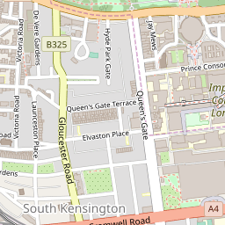
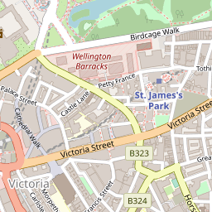
Leaflet
Leaflet is the leading open source JavaScript library for mobile-friendly interactive maps. It has all the mapping features most developers ever need.
Leaflet is designed with simplicity, performance and usability in mind. It works efficiently across all major desktop and mobile platforms, can be extended with lots of plugins, has a beautiful, easy to use and well-documented API and a simple, readable source code that is a joy to contribute to.
L.tileLayer('https://api.mapbox.com/styles/v1/{id}/tiles/{z}/{x}/{y}?access_toke={accessToken }', { attribution: 'Map data &copy;
<a href="https://www.openstreetmap.org/">OpenStreetMap</a> contributors,
<a href="https://creativecommons.org/licenses/by-sa/2.0/">CC-BY-SA</a>,Imagery ©
<a href="https://www.mapbox.com/">Mapbox</a>’,
maxZoom: 18,
id: ‘mapbox/streets-v11’,
tileSize: 512,
zoomOffset: -1,
accessToken: 'your.mapbox.access.token’
}).addTo(mymap);

Slide 10
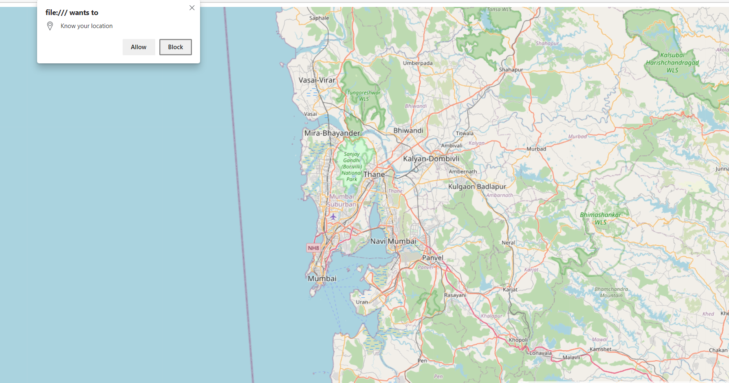
Tile Layer

Slide 11
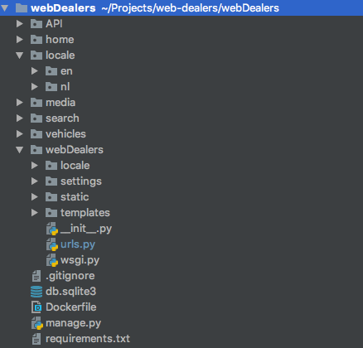
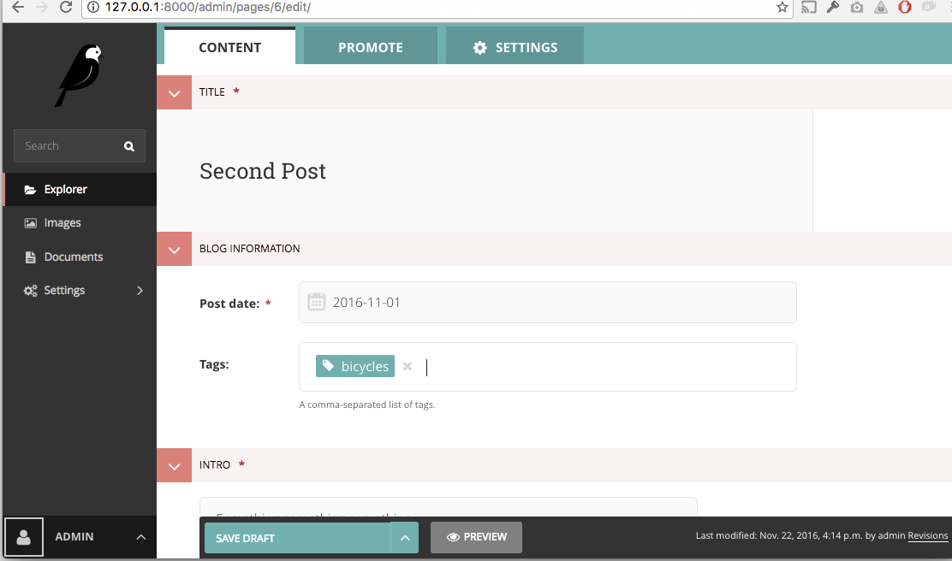
Wagtail (CMS)
Wagtail is a free and open source Content Management System (CMS) written in Python. It is popular amongst websites using the Django framework. The project has a focus on developer friendliness as well as ease of use of its administration interface, translated in multiple languages.

Slide 12
Data Conversion
The data obtained from site visiting done by TDSC members is in XML and KML format for the attribute table and the locations respectively. These data are collected using the ODK Collect Mobile app.
Once we get the data, the XML file needs to be in the CSV format, which is achieved using the python script.
Then for the KML data, one has to separate it based on the villages and geometries. Done through the google earth.
This KML file is converted into a shapefile using the QGIS software.
Now the task is to combine the shapefile of geometries with their attr1ibutes in the CSV format. This is done using the merge layer feature of QGIS.
The Shapefile obtained contains both the location geometry and the characteristics of the place
XML
(attribute table)
CSV file
(attribute table)
merge
Attributes
Locations
KML
(location co-ordinates)
Shapefile
(location co-ordinates)
Shapefile

Slide 13
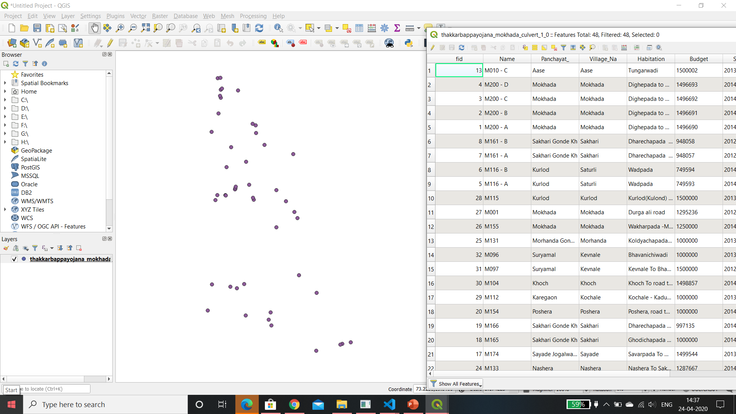
Location and Attribute Table

Slide 14
Progress
Worked on the initial informative and interactive website development of UMA.
Learned Wagtail CMS for the website development.
Working on the setting up of centralized server that will be used as a repository for all the TDSC spatial and non-spatial data.
Working on the interface of community GIS, to provide extra functionality to the existing one. Till now TBY and RWS projects are under progress.
Learning the conversion of data from various document and visualization formats to shapefile formats using QGIS Desktop.
Learned the integration of PostgreSQL with QGIS using PostGIS.
Learned to use Geocoding to obtain locations using the name of institutes for UMA.
Made documentation to help TDSC members learn the use of internal server and data conversion techniques.

Slide 15
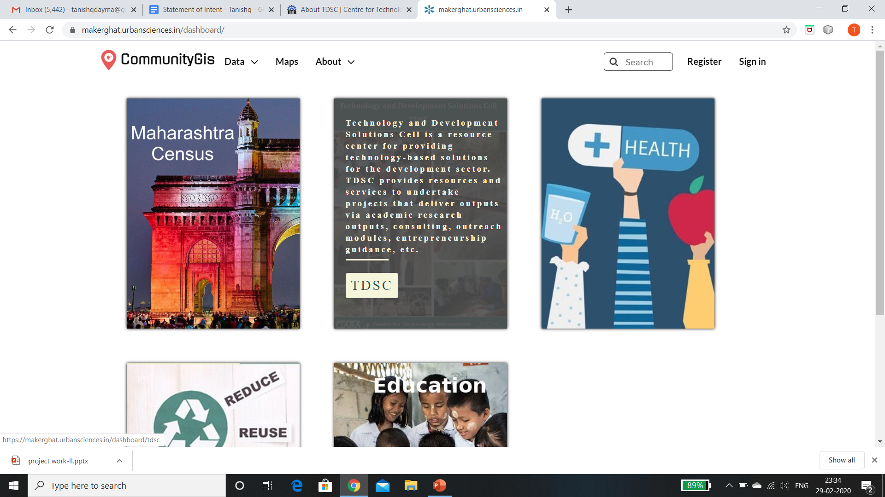
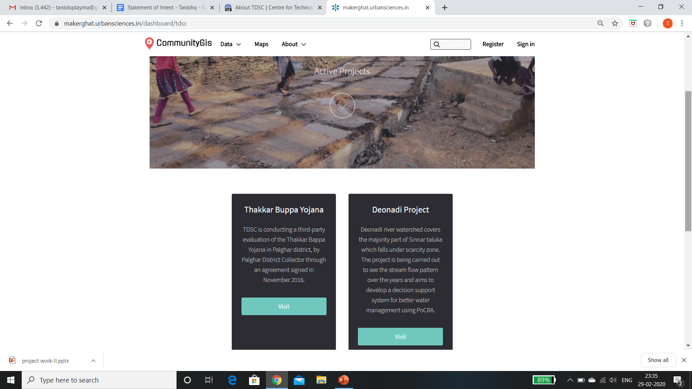
Projects of TDSC on CommunityGIS

Slide 16
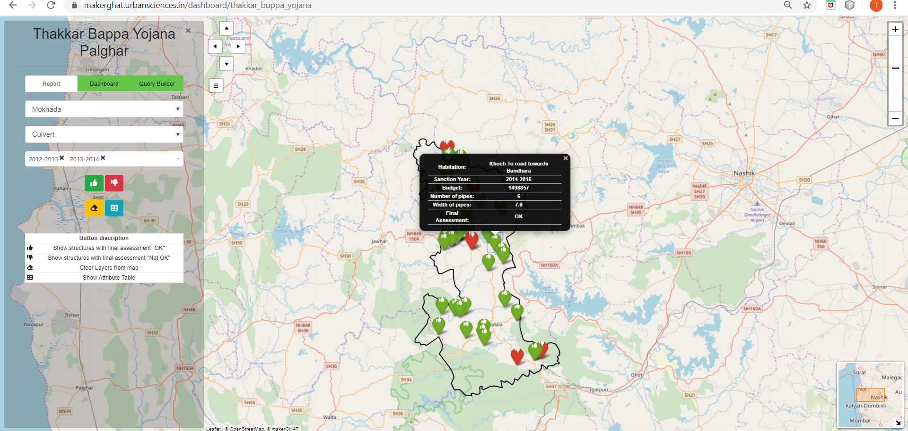
Block-wise visualization of structures in TBY Project

Slide 17
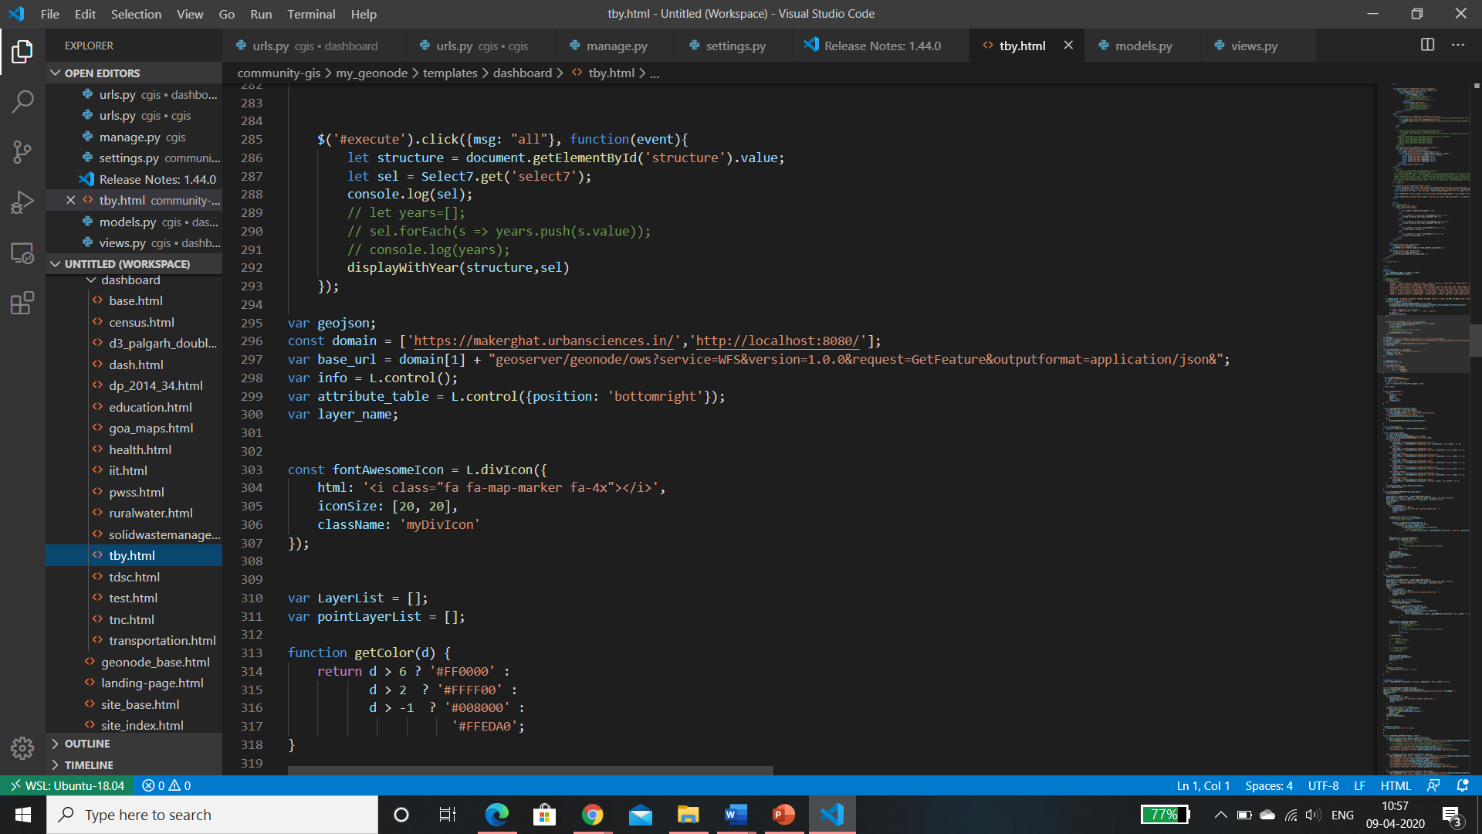
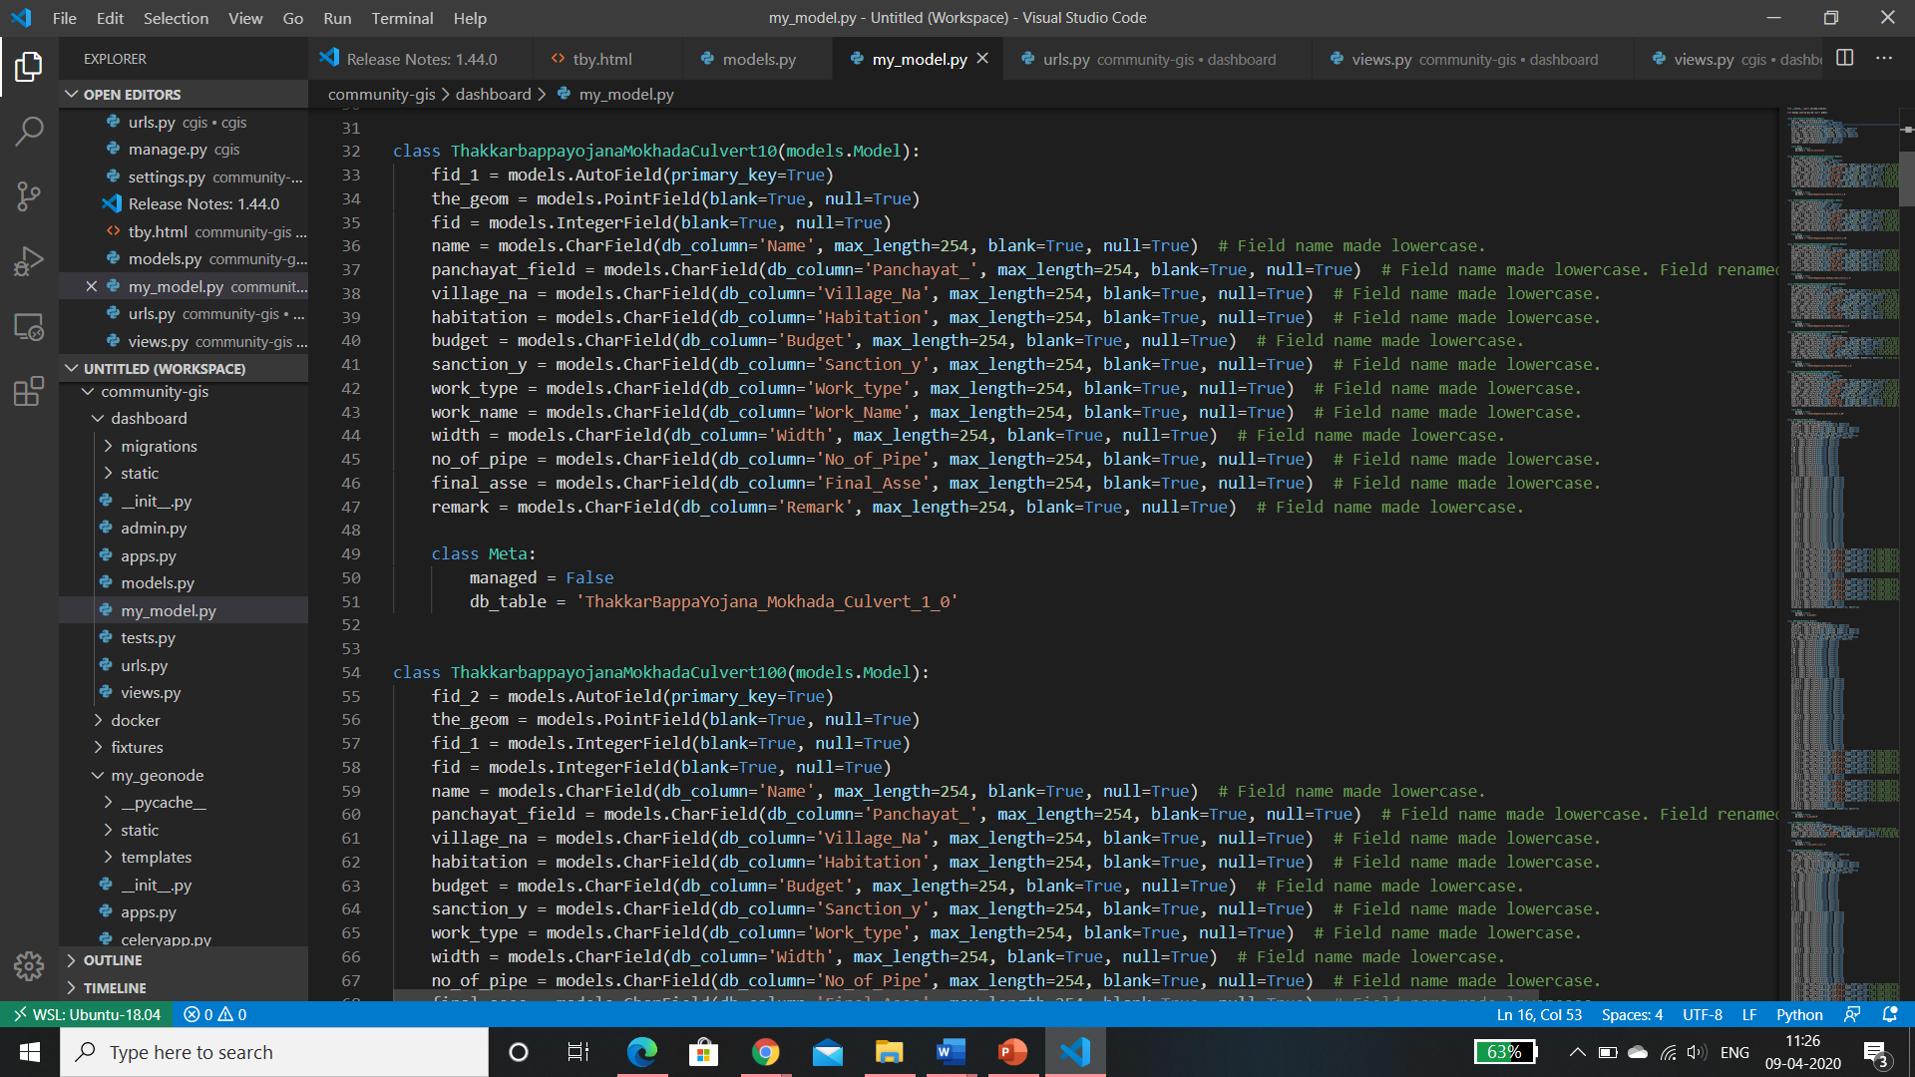
Domain and Model for TBY

Slide 18
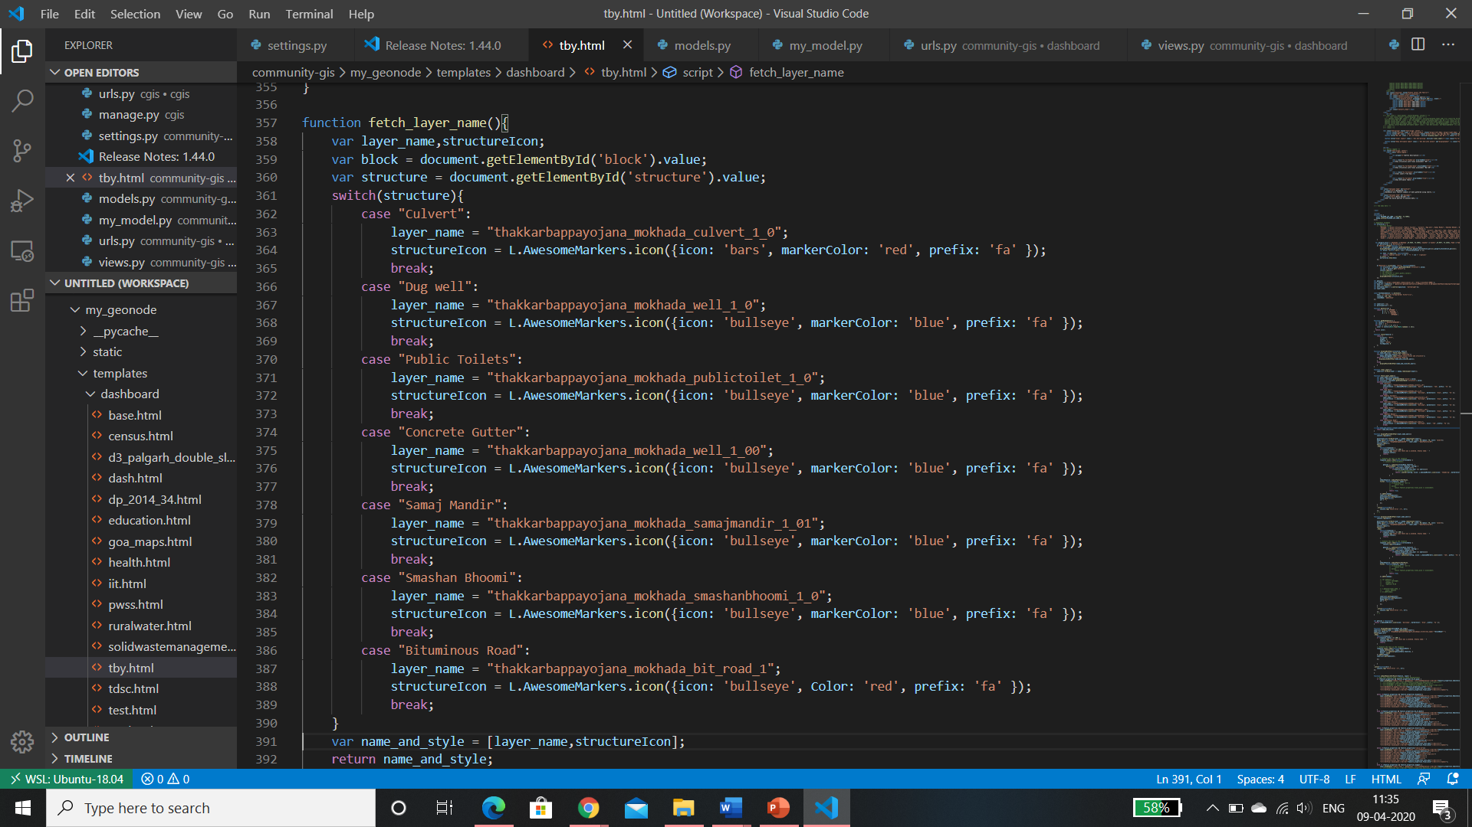
fetch_layer_name Function

Slide 19
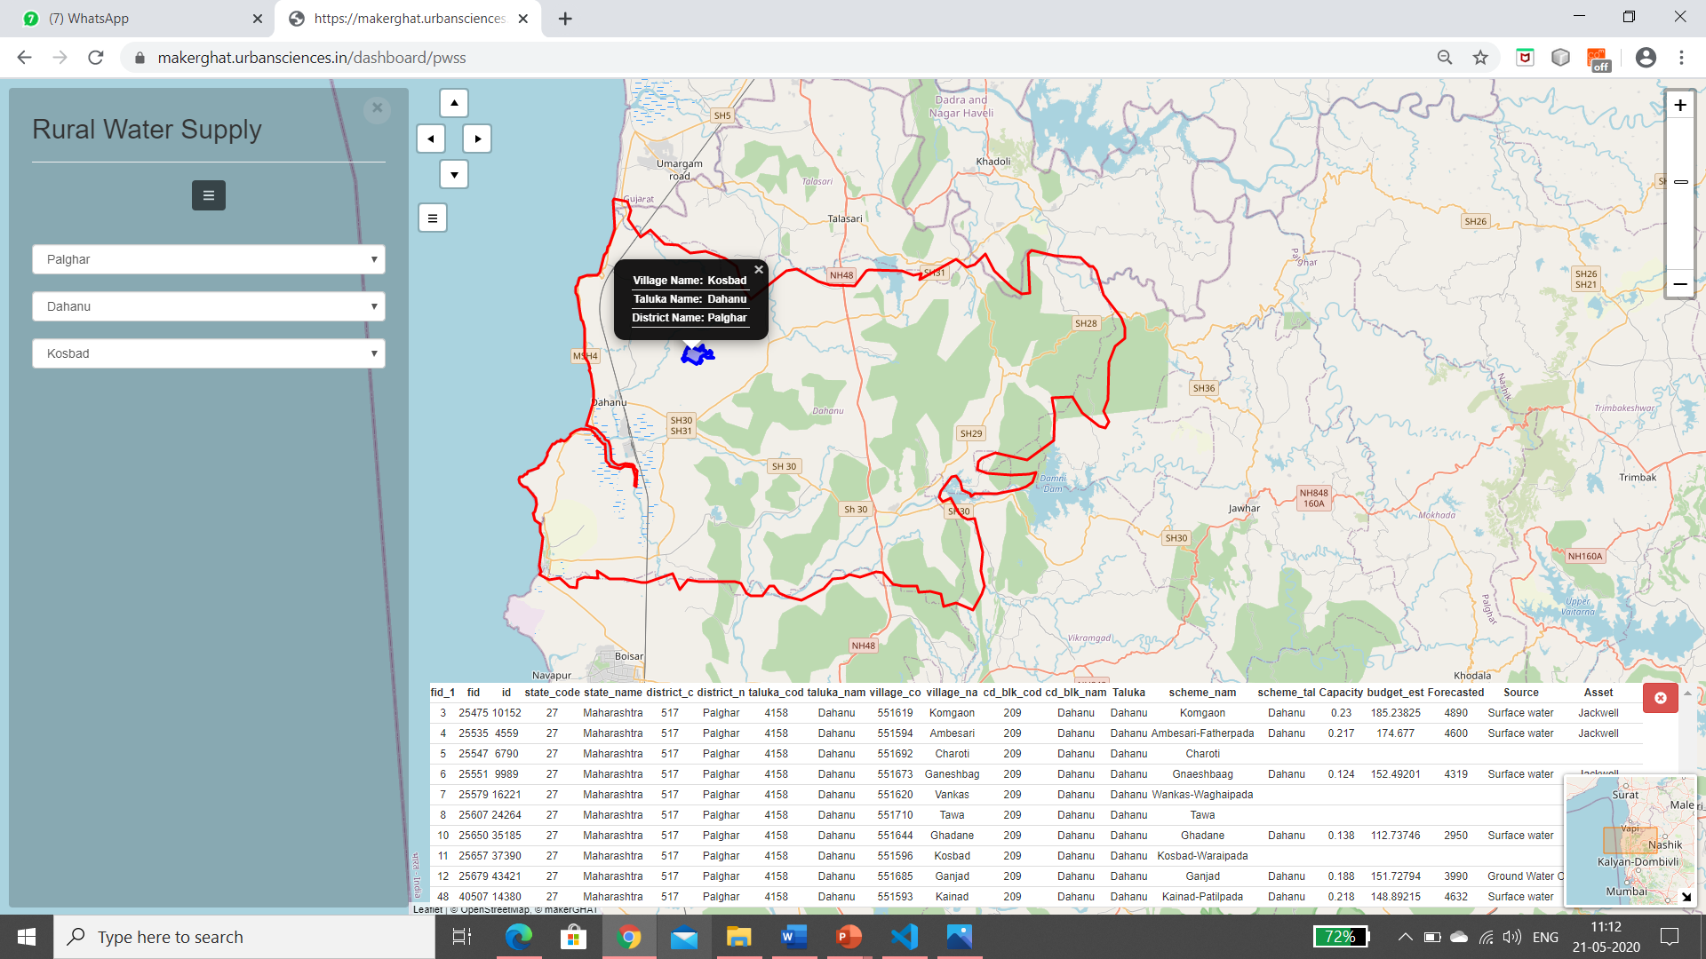
Displaying village polygon – Rural Water Supply Scheme

Slide 20
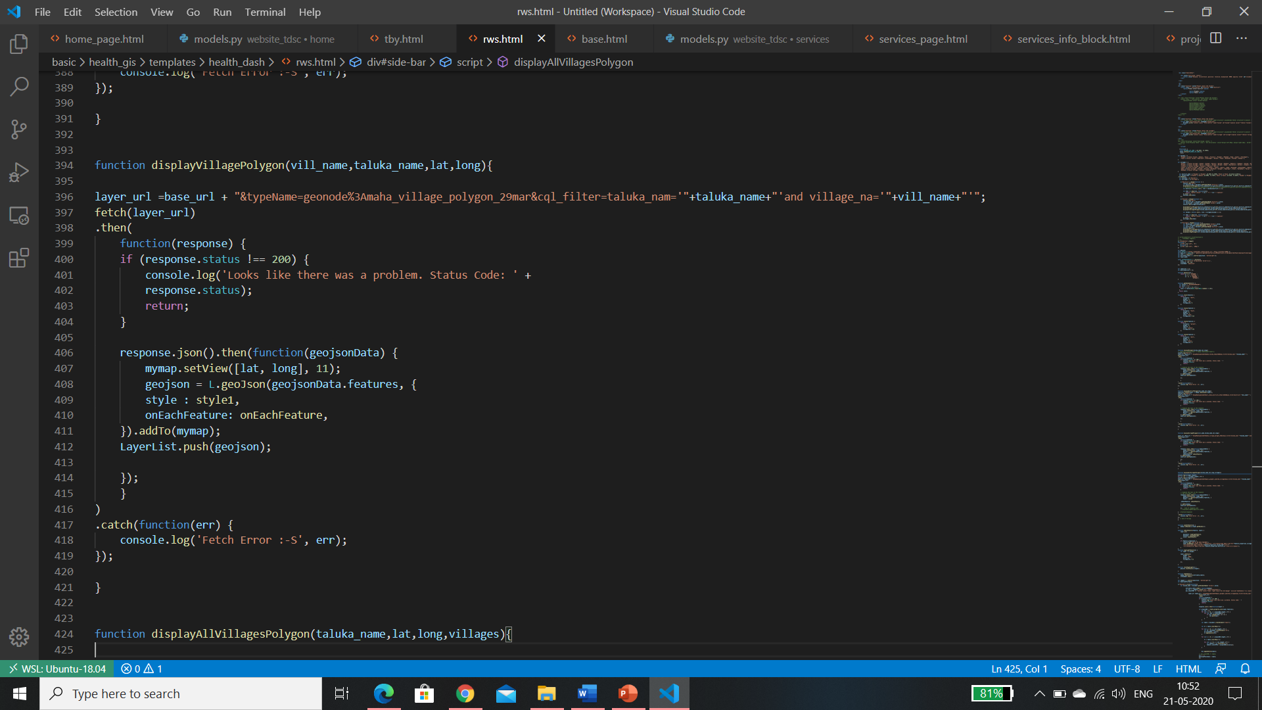
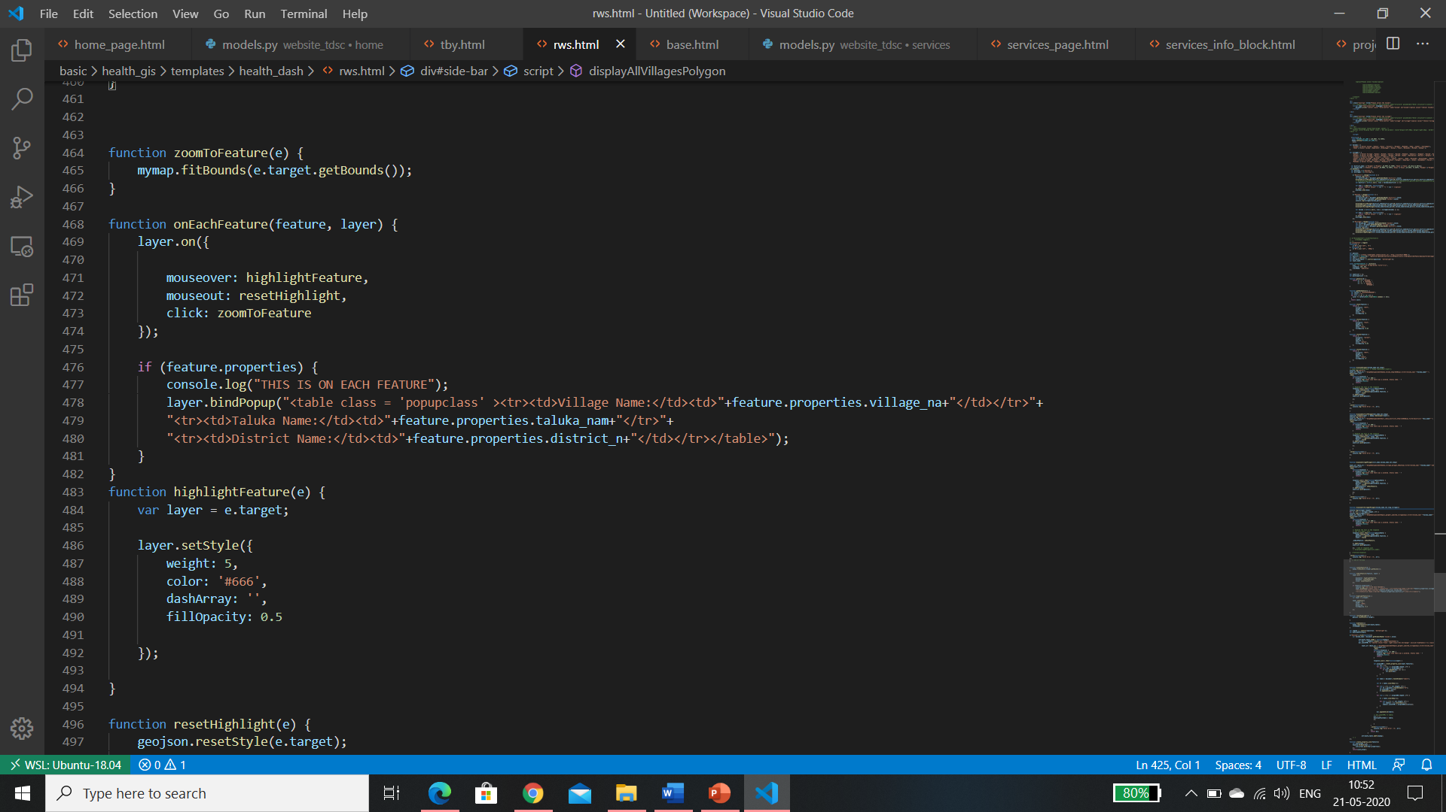
displayVillagePolygon Function

Slide 21
Thank You

